Slide 1

Data Structures Binary Search Trees I
Dr. Wedad Hussein
Information Systems Department
wedad.hussein@cis.asu.edu.eg
Dr. Hanan Hindy
Computer Science Department
hanan.hindy@cis.asu.edu.eg

Slide 2
Course Contents
Pointers & Classes.
Stacks
Queues
Array Lists
Linked Lists
Binary Search Trees I
Binary Search Trees II +STL
Hash Tables

Slide 3
Linear vs. Non-Linear Data Structures
Linear
Stacks
Queues
Non-Linear
Trees
Graphs
Lists

Slide 4
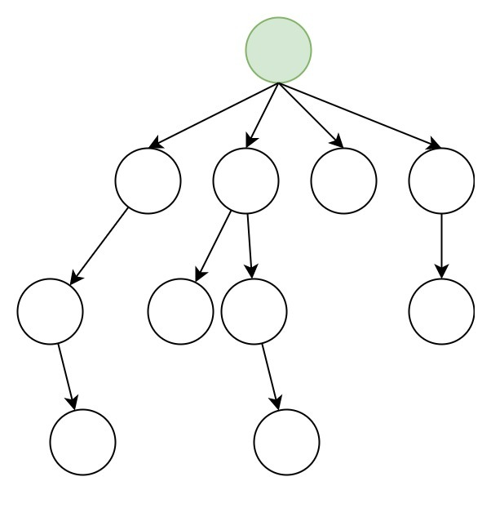
Trees
Notes:
Terminologies: https://www.gatevidyalay.com/tree-data-structure-tree-terminology/

Slide 5
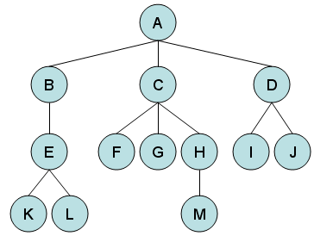
Terminologies
In any tree, there must be only one root node
Root
Edge
Parent
Child
Siblings
Leaf Nodes
Notes:
In a tree with n number of nodes, there are exactly (n-1) number of edges.

Slide 6
Terminologies - Cont
Subtree

Slide 7
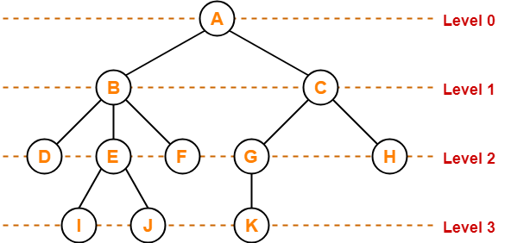
Terminologies - Cont

Slide 8
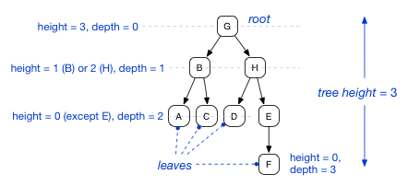
Terminologies - Cont
Notes:
A node’s height is the number of edges to its most distant leaf node.
A node’s depth is the number of edges back up to the root.
So, the root always has a depth of 0 while leaf nodes always have a height of 0.
The terms “level” and “depth” are used interchangeably.

Slide 9
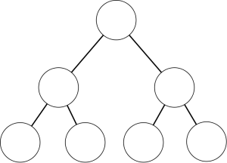
Binary Trees

Slide 10
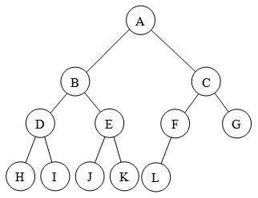
Binary Tree
A binary tree is a tree in which no node can have more than two children.

Slide 11
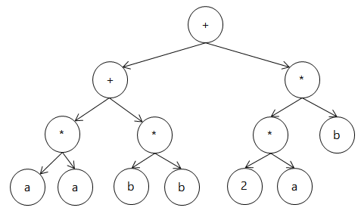
Application: Expression Tree
For the expression: (a*b+c*d) + (e*f*g)
+
+
*
*
*
*
g
a
b
c
d
e
f

Slide 12
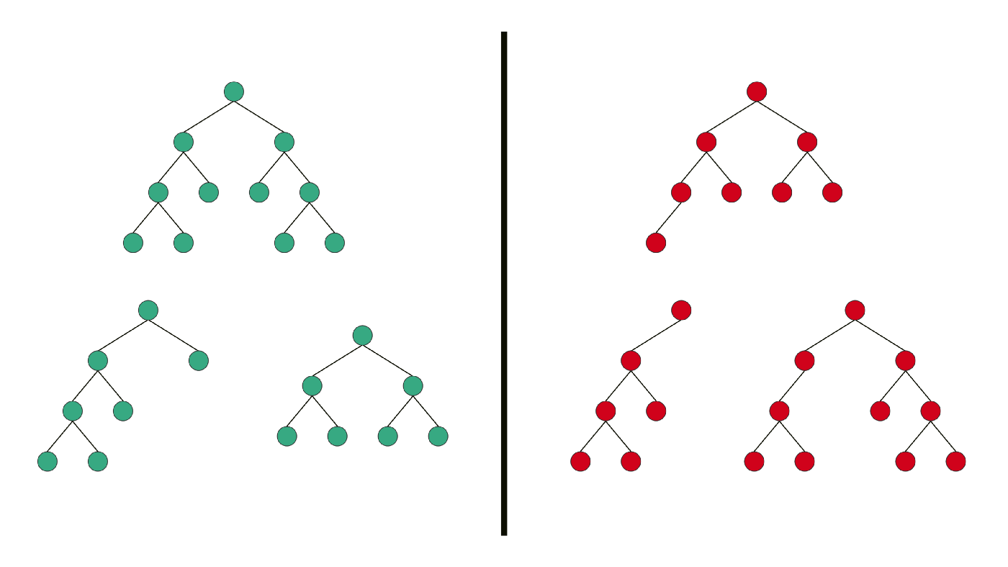
Types
Full Binary Tree is a Binary Tree in which every node has 0 or 2 children.

Slide 13
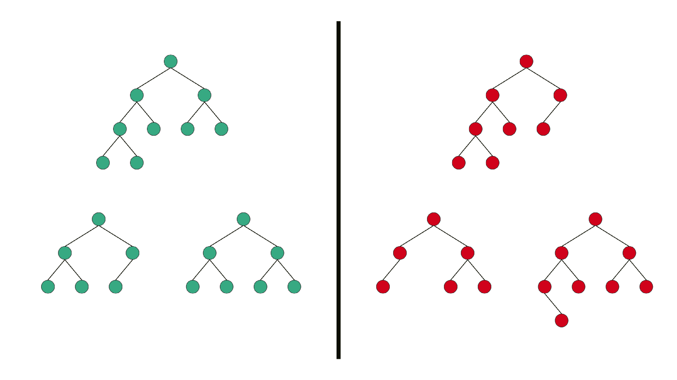
Types
Complete Binary Tree has all levels completely filled with nodes except the last level and in the last level, all the nodes are as left side as possible.

Slide 14
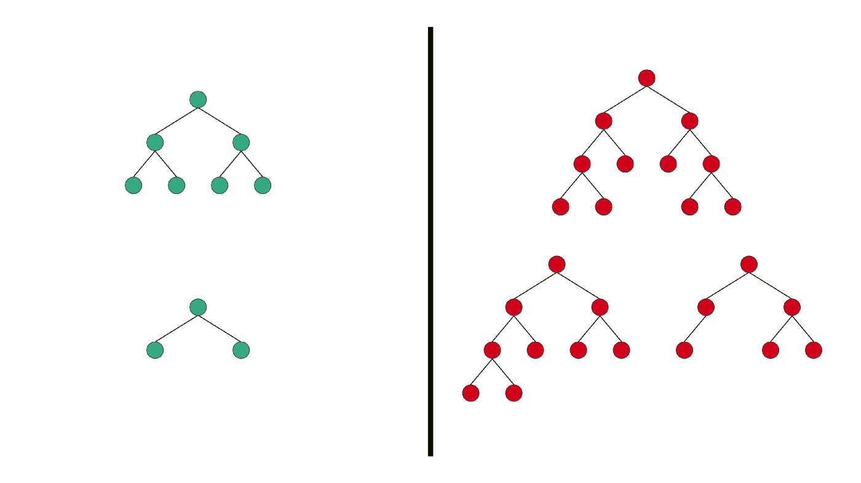
Types
Perfect Binary Tree is a Binary Tree in which all internal nodes have 2 children, and all the leaf nodes are at the same depth or same level.

Slide 15
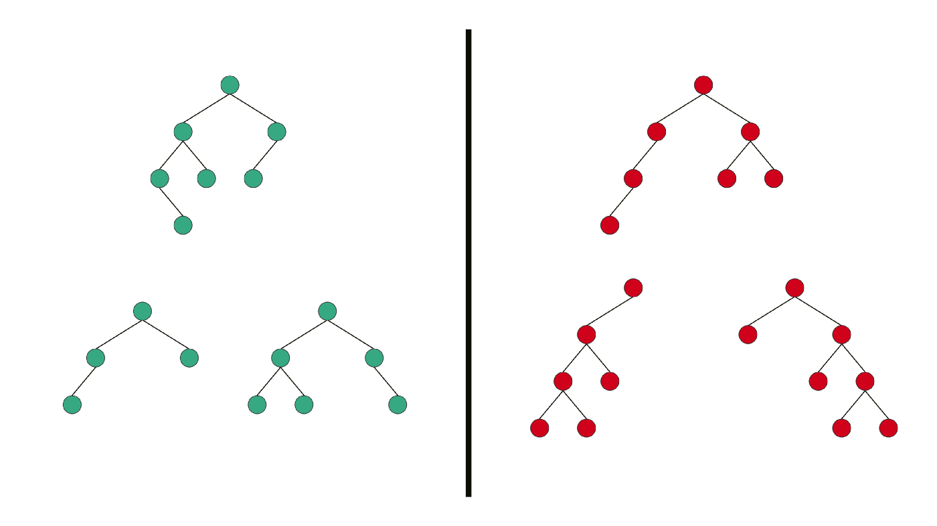
Types
Balanced Binary Tree is a Binary tree in which height of the left and the right sub-trees of every node may differ by at most 1.

Slide 16
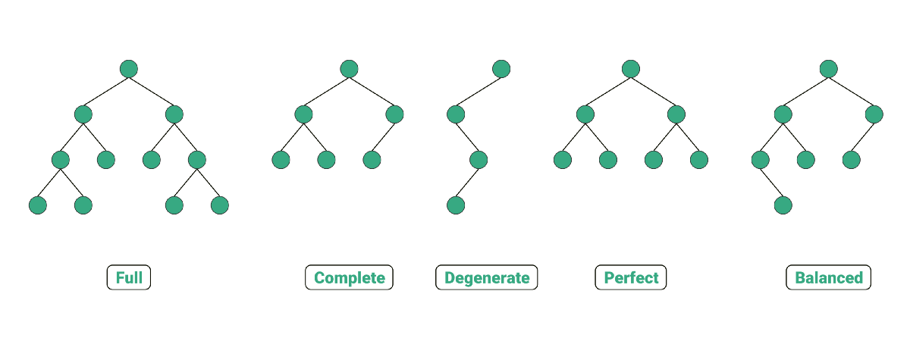
Types

Slide 17
Binary Search Trees

Slide 18
Binary Search Tree (BST)
An important application of binary trees is their use in searching.
The property that makes a binary tree into a binary search tree is that for every node X:
the values of all the items in its left subtree are smaller than the item in X.
and, the values of all the items in its right subtree are larger than the item in X.
The average running time of most operations is O(logN).

Slide 19
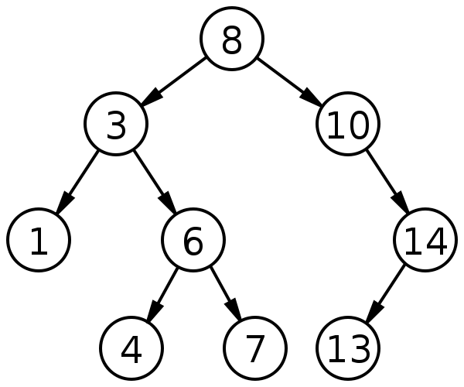
Binary Search Tree Example

Slide 20
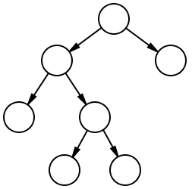
Which is a BST?
(1)
(2)
6
6
2
8
2
8
1
4
1
4
3
7
3
7

Slide 21
Binary Search Trees Implementation

Slide 22
Tree Node
template <class T>
class Node
{
T value;
Node<T> *left;
Node<T> *right;
};
Value
Left
Right

Slide 23
BST Operations
Contains(value): returns true if “value” exists in the tree.
Insert(value): adds a value to the tree.
Traverse: (display) displays all nodes in the tree.
Remove(value): deletes a node from the tree.

Slide 24
Contains
60
>55
Find(55)
41
74
16
53
65
25
46
55
63
70
42
64

Slide 25
Contains
60
Find(55)
41
74
<55
16
53
65
25
46
55
63
70
42
64

Slide 26
Contains
60
Find(55)
41
74
16
53
<55
65
25
46
55
63
70
42
64

Slide 27
Contains
60
Find(55)
41
74
16
53
65
25
46
55
63
70
42
64

Slide 28
Insert
60
>48
Insert (48)
Has left child
41
74
16
53
65
25
46
55
63
70
42
64

Slide 29
Insert
60
Insert (48)
41
74
<48
Has right child
16
53
65
25
46
55
63
70
42
64

Slide 30
Insert
60
Insert (48)
41
74
16
53
>48
65
Has left child
25
46
55
63
70
42
64

Slide 31
Insert
60
Insert (48)
41
74
16
53
65
<48
25
46
55
63
70
42
64
Has no right Child

Slide 32
Insert
60
Insert (48)
41
74
16
53
65
25
46
55
63
70
42
48
64

Slide 33
Exercise
Draw the Binary Search Tree resulting from inserting the following values in the same order:
100, 200, 90, 150, 125, 88, 99, 210

Slide 34
Solution
100
90
200
88
99
150
210
125

Slide 35
Tree Traversal
A tree traversal is a specific order in which to trace the nodes of a tree.
There are 3 common methods:
In-order: left, root, right.
Pre-order: root, left, right.
Post-order: left, right, root.

Slide 36
Tree Traversal - In-order
For a Binary Search Tree, it prints out a sorted list.
63
7
11
3
41
74
5
1
16
53
65
9
4
6
8
2
25
46
55
64
70
10
The In-order traversal gives: 16, 25, 41, 46, 53, 55, 63, 64, 65, 70, 74.
Notes:
left, root, right.

Slide 37
Tree Traversal - Pre-order
Useful for displaying folders and subfolders.
63
1
8
2
41
74
5
3
16
53
65
9
4
6
7
10
11
25
46
55
64
70
The Pre-order traversal gives: 63, 41, 16, 25, 53, 46, 55, 74, 65, 64, 70.
Notes:
root, left, right.

Slide 38
Tree Traversal - Post-order
63
11
Useful for displaying folders and subfolders.
10
6
41
74
5
2
16
53
65
9
3
4
7
1
8
25
46
55
64
70
The Post-order traversal gives: 25, 16, 46, 55, 53, 41, 64, 70, 65, 74, 63.
Notes:
left, right, root.

Slide 39
Competition (3 points)
Add the following function to your BSTree class
displayTreeType();
The function should display the type of the tree. (i.e., perfect, complete, balanced, etc.)
If multiple types are valid, all should be printed.
Upload the .cpp file to this form: https://forms.gle/ZrWt56deA8JZ2jmZA
Deadline: 13th April 2022 11:59PM
Any copies found will be given negative points and will exclude its owner from the competition for the rest of the term.

Slide 40
Lecture Resources
Lecture Notes.
Lecture Code.
Text Book:
Chapter 4: 4.1, 4.2, 4.3

Slide 41


